Slide 1
LED, BETWEEN MODE AND LONG TERM EFFICIENCY
Prof.dr.ing. Cătălin-D. Gălăţanu

Slide 2
FEASIBILITY STUDY FOR THE REPLACEMENT OF CLASSICAL LED LIGHT SYSTEMS IN LOCALITIES IN THE MUNICIPALITY OF REŞIŢA: CÂLNIC, ŢEROVA, DOMAN, SECU, CUPTOARE AND MONIOM
The object of the study - 6 localities belonging to the municipality of Resita: Câlnic, Ţerova, Doman, Secu, Furnaces and Moniom.
This study aimed at upgrading the street public lighting system where the existing lighting is deficient and degraded to a great extent (the last major modernization of the lighting system took place in 2006 when generating the lighting with sodium vapor lamps).
In general, the lighting requirements imposed by the SR 13433 standard were not ensured, and the energy consumption is a determinant performance criterion, having a negative effect on the community budget (most of the areas close to Reşiţa).

Slide 3
FEASIBILITY STUDY FOR THE REPLACEMENT OF CLASSICAL LED LIGHT SYSTEMS IN LOCALITIES IN THE MUNICIPALITY OF REŞIŢA: CÂLNIC, ŢEROVA, DOMAN, SECU, CUPTOARE AND MONIOM
The object of the study included the modernization of the street public lighting systems related to national, county and village roads in the aforementioned districts having a total length of about 29.45 km.
The analyzed lighting systems comprise about 908 aerial poles (mostly non-isolated) equipped with about 802 luminaires.
Lighting fixtures are mostly equipped with 70, 100 or 150W sodium lamps.

Slide 4
FEASIBILITY STUDY FOR THE REPLACEMENT OF CLASSICAL LED LIGHT SYSTEMS IN LOCALITIES IN THE MUNICIPALITY OF REŞIŢA: CÂLNIC, ŢEROVA, DOMAN, SECU, CUPTOARE AND MONIOM
Increasing the overall efficiency of the lighting system, reflected by increasing the level of illumination simultaneously with the decrease in energy consumption, is the main element of progress of the project.
The modernization of the street public lighting consists in combining and balancing the theoretical solutions with the practical and economic ones (low energy consumption, minimal maintenance and installation costs, and the total costs of the lighting system administrator).
It can be appreciated that achieving a comfortable light climate with minimal energy consumption with the most intense use of efficient and reliable lighting sources and luminaires and a minimum investment is a criterion for appreciating a modern lighting system efficient.

Slide 5
FEASIBILITY STUDY FOR THE REPLACEMENT OF CLASSICAL LED LIGHT SYSTEMS IN LOCALITIES IN THE MUNICIPALITY OF REŞIŢA: CÂLNIC, ŢEROVA, DOMAN, SECU, CUPTOARE AND MONIOM
Bringing street public lighting to the parameters set by SR 13433/99 as well as alignment with European norms required the change of incandescent lamps and lighting fixtures with reliable and efficient lamps, the arguments presented both on the indirect and economic benefits line reveal the necessity of increasing the efficiency of street public lighting In the neighboring areas of Resita.
According to SR 13433/99 and the technical norms in force, the streets were light-technical in the ME5 category.
In all areas around Resita, the existing lighting fixtures have been replaced with 65W led lamps.
In the Doman district, where lighting was generally disposed of 2 in 2 pillars, the amplification of the lighting system was made by equipping all the pillars in the existing power grid, where consoles and lighting fixtures would be mounted.

Slide 6
Street centralizer on the projected situation of rehabilitated public lighting systems
Nr. Crt. | Strada | Nr. total stalpi existenti | Nr. total corpuri ilum. Existente | Putere instalata existenta [W] | Nr. total corpuri ilum. Propuse | Putere instalata unitara in corpul modernizat [W] | Putere instalata propusa [W]
0 | 1 | 2 | 3 | 4 | 5 | 6 | 7
a | Câlnic | 177 | 178 | 12460 | 178 | 65 | 11570
b | Cuptoare | 119 | 110 | 7700 | 110 | 65 | 7150
c1 | Driglovăţ, din care | 42 | 42 | 4200 | 42 | 65 | 2730
c2 | Zonă străzi acces spre Driglovăţ | 60 | 47 | 3620 | 60 | 65 | 3900
d | Doman | 159 | 91 | 6370 | 166 | 65 | 10790
e | Moniom | 65 | 60 | 9000 | 60 | 65 | 3900
f | Poiana Golului | 66 | 63 | 4970 | 63 | 65 | 3105
g | Secu | 132 | 123 | 8610 | 123 | 65 | 7995
h | Ţerova | 88 | 88 | 6160 | 88 | 65 | 5720
 | TOTAL | 908 | 802 | 63090 | 890 |  | 56860

Slide 7
FEASIBILITY STUDY FOR THE REPLACEMENT OF CLASSICAL LED LIGHT SYSTEMS IN LOCALITIES IN THE MUNICIPALITY OF REŞIŢA: CÂLNIC, ŢEROVA, DOMAN, SECU, CUPTOARE AND MONIOM
Capacities (in physical and value units)
There will be modernization in terms of lighting technology and brought to the level of the standards in force a number of 6 neighboring localities in the municipality of Reşiţa having a total length of approximately 29.45 km, the installed existing electric power decreasing from 63.09kW (76kW inclusive Loss on ballasts) to about 56.86kW.
These streets will be equipped with an additional number of 88 new lighting fixtures, the total number of new bodies being 890 pieces.

Slide 8
FEASIBILITY STUDY FOR THE REPLACEMENT OF CLASSICAL LED LIGHT SYSTEMS IN LOCALITIES IN THE MUNICIPALITY OF REŞIŢA: CÂLNIC, ŢEROVA, DOMAN, SECU, CUPTOARE AND MONIOM
Other indicators specific to the field of activity where the investment is made:
A) before the investment is made:
Specific annual electricity consumption (lei / km): 9559.0 RON / km / year
Annual specific electricity loss (kWh / km): 2760.0 kWh / km / year
Specific power losses (kW / km): 0.778 kW / km
B) after the realization of the investment:
specific annual electricity consumption (lei / km): 4929.5 RON / km / year
Specific electricity loss (kWh / km): 488.1 kWh / km / year
Specific power losses (kW / km): 0.222 kW / km

Slide 9
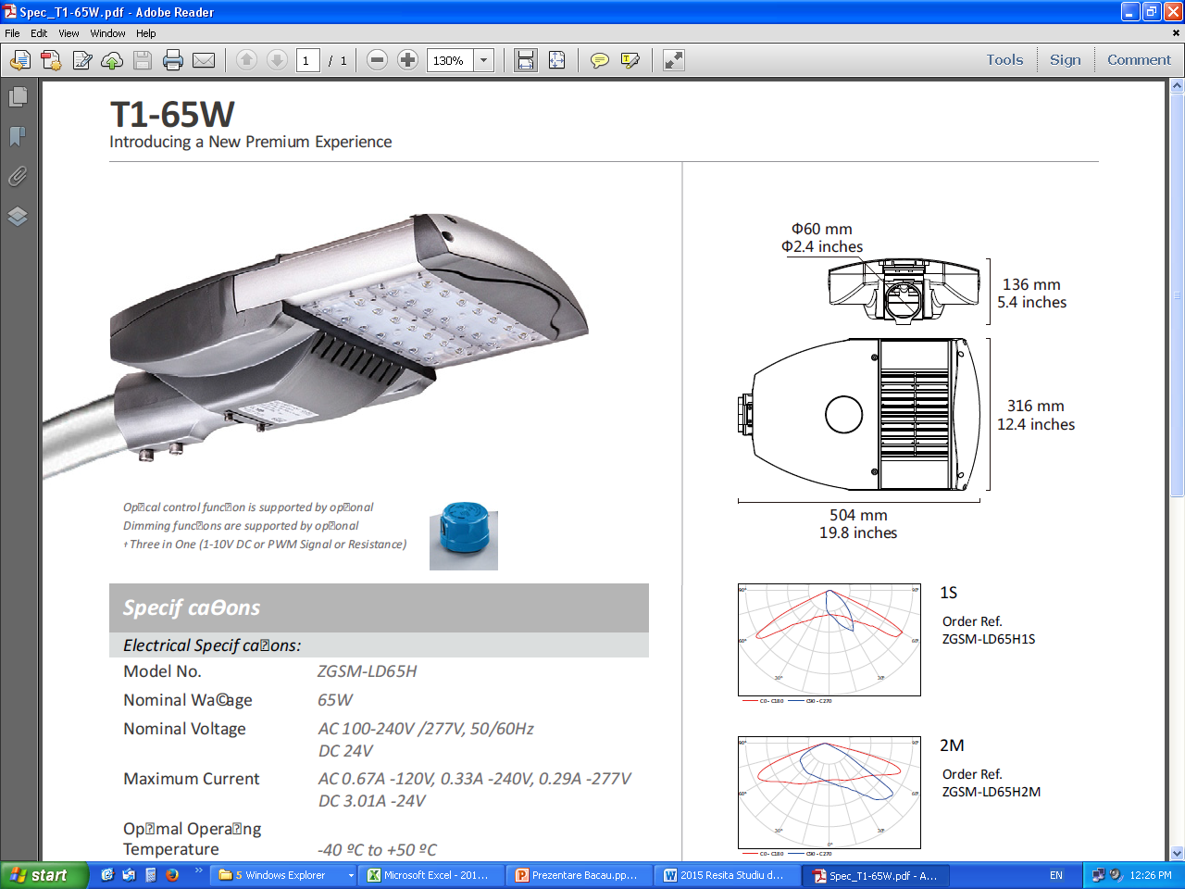
FEASIBILITY STUDY FOR THE REPLACEMENT OF CLASSICAL LED LIGHT SYSTEMS IN LOCALITIES IN THE MUNICIPALITY OF REŞIŢA: CÂLNIC, ŢEROVA, DOMAN, SECU, CUPTOARE AND MONIOM
65W LED Lighting Specifications:

Slide 10
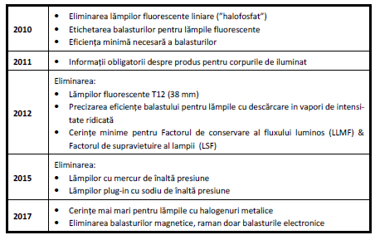
Exterior lighting - EC requirements
The EU has set new energy efficiency requirements for lamps produced on the EU market as of 1 September 2009.
EU regulation affects not only "household lamps" but also all inefficient lamps as well as inefficient ballasts and lighting fixtures:

Slide 11
Outdoor lighting - types of lamps

Slide 12
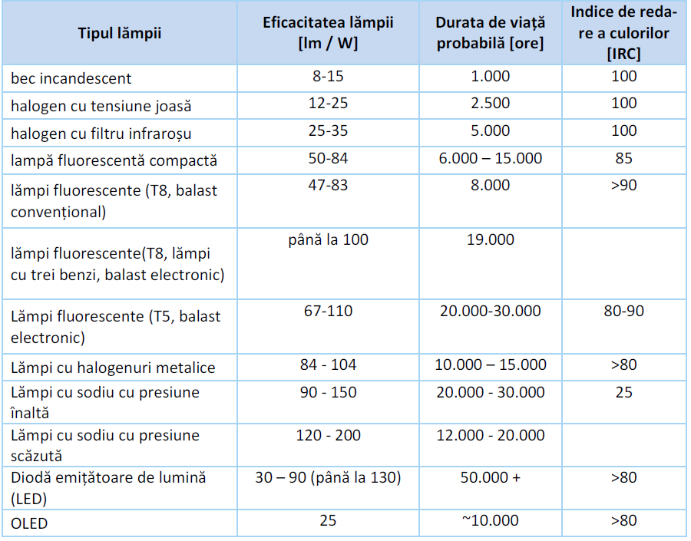
The main features of the different types of lamps:

Slide 13
Why LED?
The LED is an electronic device with a p-n junction that emits an optical radiation in the event of an electric excitation.
Advantages of the LED
Constant output color regardless of the level of illumination
It does not contain mercury
Not UV and infrared radiation
Reduces the number of insects attracted
Resistant and stable
Wide range with different levels of quality available on the market

Slide 14
Design
Direct light
Minimum side light losses (180o emission angle)
Light almost does not produce heat in the light cone
Good color rendering
Simple and flexible design for mounting and encapsulation
Efficiency & costs
Very long life (50,000 and over)
Currently, the light output of various lamps is:
CFL-approx. 60 lm / W,
"High Power LEDs" up to 100 lm / W, laboratory values up to 200 lm / W
Currently, high investment costs

Slide 15
LED Lamp - Principle Electric Circuit
700 mA
230 V; 50 Hz
F N PE
D
EMC
PFC
D
F
21 V

Slide 16
The schematic diagram of an autonomous lighting system with photovoltaic panels
Photovoltaic panel
LED Lamp
17,4 V
Battery charge controller
Controler
K
24 V
B
Sensors signal

Slide 17
Technical specifications of some batteries used to store solar energy
A) The life span of various types of gel batteries depending on the ambient temperature

Slide 18
Technical specifications of some batteries used to store solar energy
B) Number of cycles supported by different types of gel batteries depending on the discharge level

Slide 19
Technical and economical analysis of an energy-led led lighting system produced by solar panels
It has been attempted to replace existing luminaires equipped with classical lamps through LEDs. By replacing existing light sources with LED light sources that will provide higher levels of illumination than those of the present, more appropriate to the purpose and destination of the roadway, improved visual comfort.
By using solar panels, it was intended to reduce the cost of electricity to zero.
An analysis of indirect benefits and costs may take into account two aspects: reducing maintenance costs and reducing electricity consumption in public street lighting.

Slide 20
Technical and economical analysis of an energy-led led lighting system produced by solar panels
The materialization of the proposed solution for the modernization of the lighting system involves the execution of the following categories of works:
Replacement of existing street lighting with new, modular, LED, 40-60W, depending on the class of illumination adopted according to SR13433 / 99
Giving up electricity from the public system
Installation of 60-90-120W Solar Panel Systems with local power storage and its subsequent use at night when supplying the LED lighting body

Slide 21
Technical and economical analysis of an energy-led led lighting system produced by solar panels
The economic analysis was considered for the classic system:
Periodic replacement of lamps, which at present according to field studies are economic, of relatively low power, whose lifetime is about one year;
An annual revision of the entire lighting system.
For the upgraded system, according to the working parameters of the electrical energy storage elements, it was considered:
Replacing batteries every four years
A periodic replacement / maintenance of the load module every five years, and
An annual revision of the entire lighting system.

Slide 22
Technical and economical analysis of an energy-led led lighting system produced by solar panels

Slide 23
Technical and economic analysis of an energy-led led lighting system produced by solar panels

Slide 24
Technical and economic analysis of an energy-led led lighting system produced by solar panels

Slide 25
Technical and economic analysis of an energy-led led lighting system produced by solar panels
Notes:
Analiza tehnică şi economică a unui sistem de iluminat cu led-uri alimentat cu energie produsă de panouri solare

Slide 26
Technical and economic analysis of an energy-led led lighting system produced by solar panels

Slide 27
Analiza tehnică şi economică a unui sistem de iluminat cu led-uri alimentat cu energie produsă de panouri solare
RATA INTERNA A RENTABILITATII FINANCIARE A INVESTITIEI - mii Euro
 | ANUL
 | 1 | 2 | 3 | 4 | 5 | 6 | 7 | 8 | 9 | 10
Vanzari | 0.051 | 0.051 | 0.052 | 0.053 | 0.054 | 0.055 | 0.056 | 0.057 | 0.058 | 0.059
Venituri totale | 0.051 | 0.051 | 0.052 | 0.053 | 0.054 | 0.055 | 0.056 | 0.057 | 0.058 | 0.059
Costuri de exploatare totale | 0.003 | 0.003 | 0.003 | 0.359 | 0.035 | 0.003 | 0.003 | 0.388 | 0.003 | 0.038
Costurile totale ale investitiei | 1.119 | 0.000 | 0.000 | 0.000 | 0.000 | 0.000 | 0.000 | 0.000 | 0.000 | -0.839
Cheltuieli totale | 1.122 | 0.003 | 0.003 | 0.359 | 0.035 | 0.003 | 0.003 | 0.388 | 0.003 | -0.801
Disponibil de numerar net | -1.071 | 0.048 | 0.049 | -0.306 | 0.019 | 0.052 | 0.053 | -0.331 | 0.055 | 0.861
Rata de actualizare | 5.0%
Rata interna a rentabilitatii financiare a investitiei | -6.7% | <5%
Valoarea actuala neta financiara a investitiei | -0.8 | <0
Raport cost - beneficiu | 0.33 | <1

Slide 28
Analiza tehnică şi economică a unui sistem de iluminat cu led-uri alimentat cu energie produsă de panouri solare
Valoarea actualizata neta raportata la investitie este negativa, ceea ce semnifică faptul ca proiectul nu poate fi realizat de beneficiar deoarece nu generează suficiente economii la bugetul beneficiarului pentru amortizarea investitiei.
Fluxul cumulat de numerar, nu prezinta valori pozitive pe fiecare an, ceea ce dovedeste ca proiectul nu este durabil din punct de vedere financiar.
Totuşi, acest proiect fiind un proiect de infrastructură de utilitate publică, el va necesita surse de finanţare nerambursabile.
Daca analiza economica s-ar face pentru corpuri de iluminat clasice cu vapori de sodiu de 70-125W (si nu cu lampi economice), economiile generate la bugetul beneficiarului prin utilizarea lampilor cu leduri ar fi permis amortizarea investitiei cu necesitatea mai redusa a unor surse de finanţare nerambursabile.

Slide 29
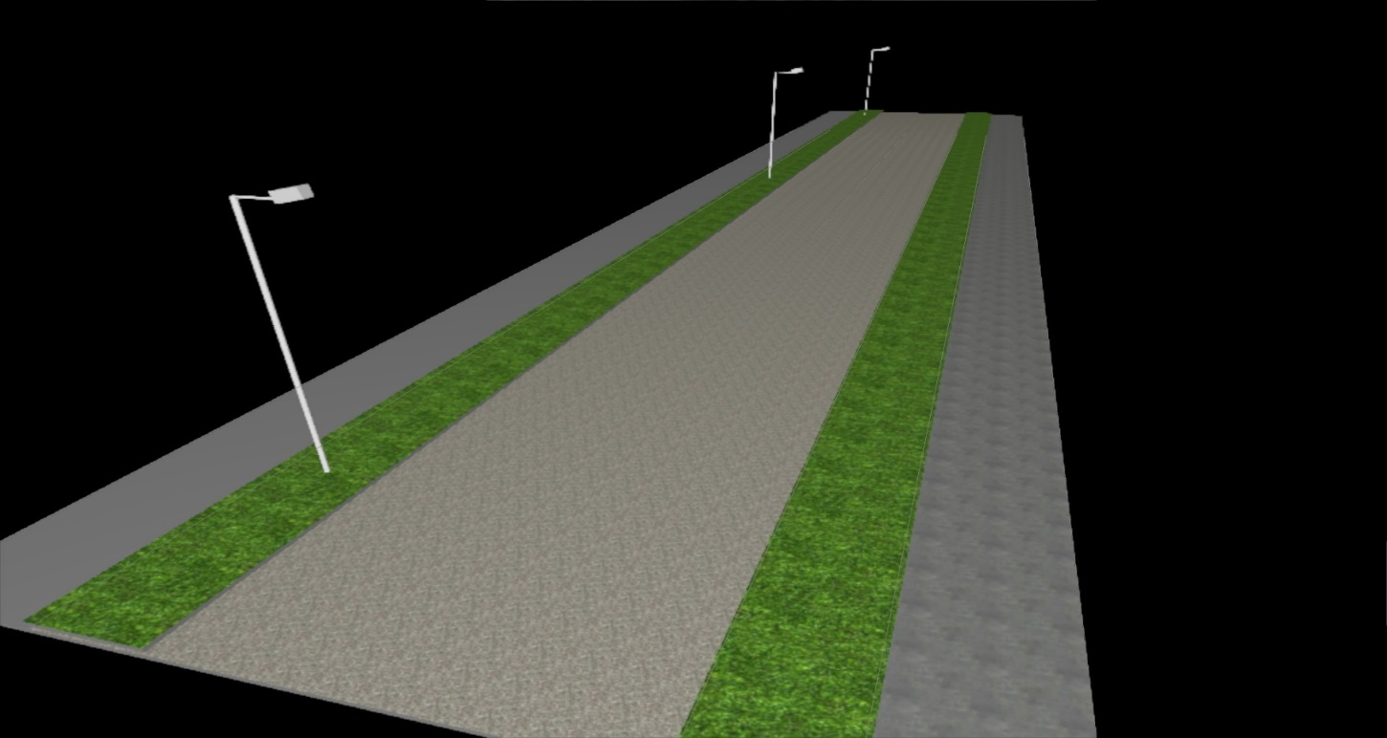
The classic solution

Slide 30
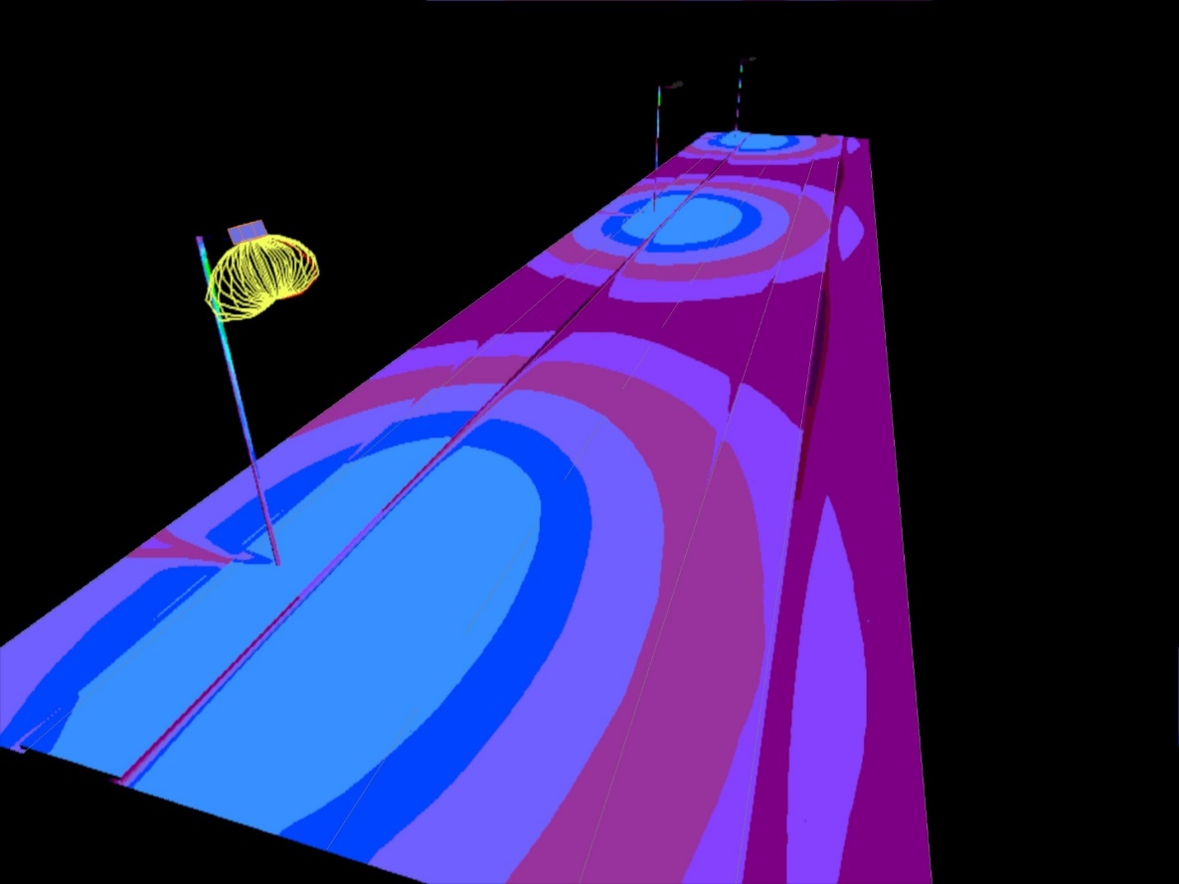
Classic system, HPS

Slide 31
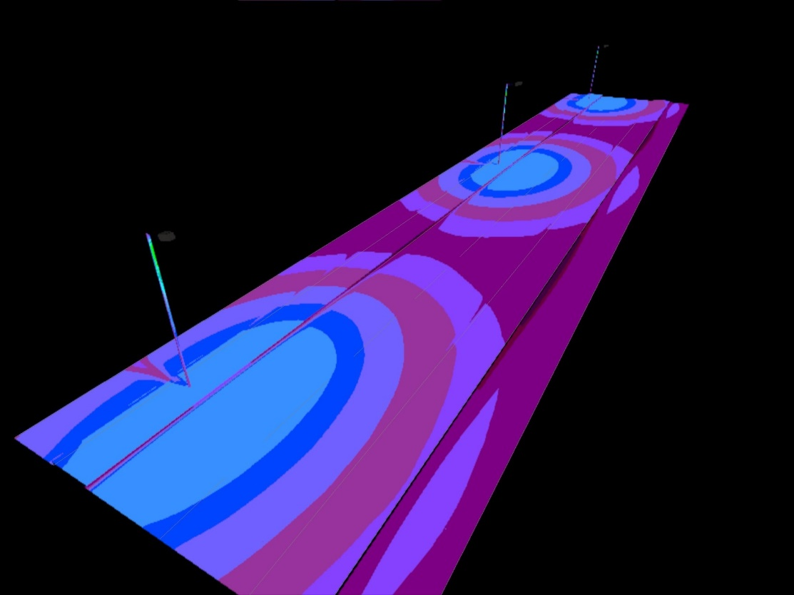
Classic system, fake colors

Slide 32
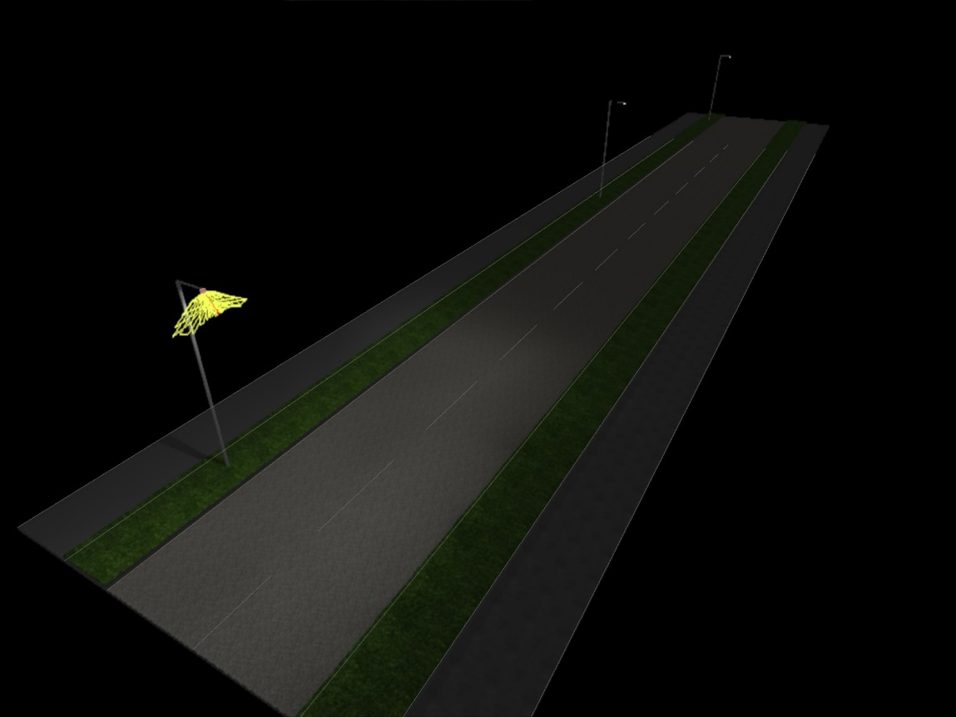
LED System “clasic”!

Slide 33
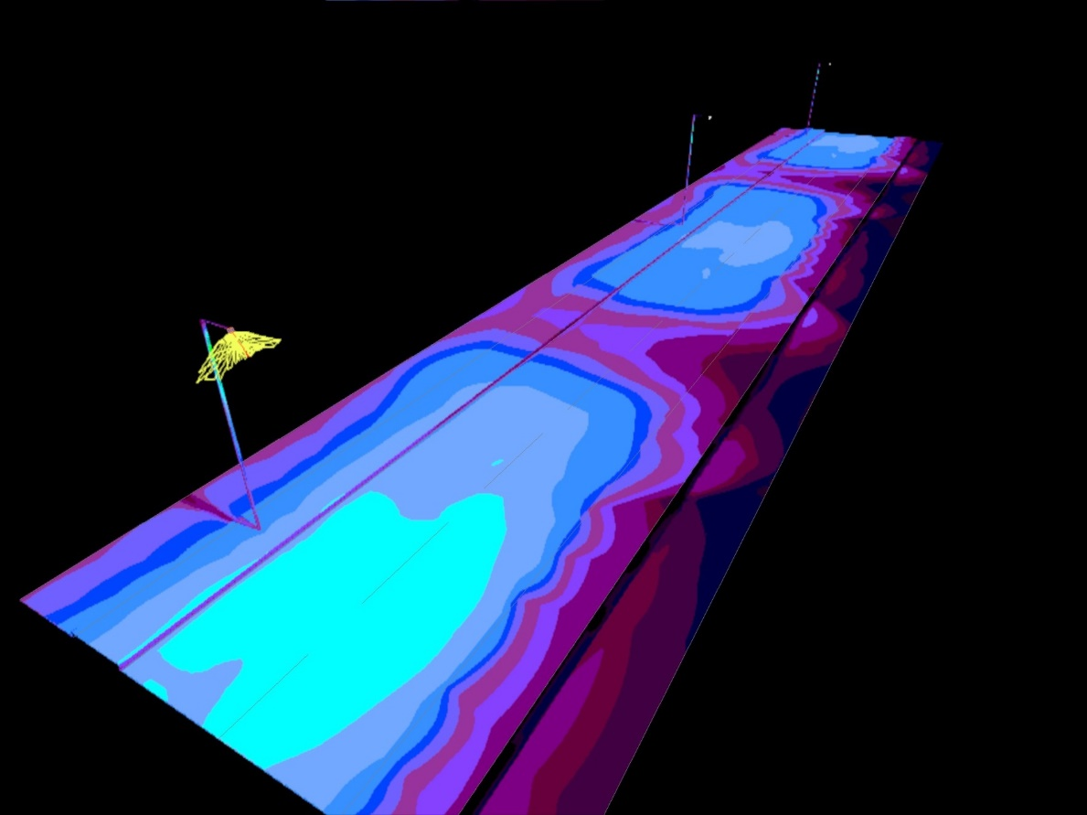
LED system, classic distribution!

Slide 34
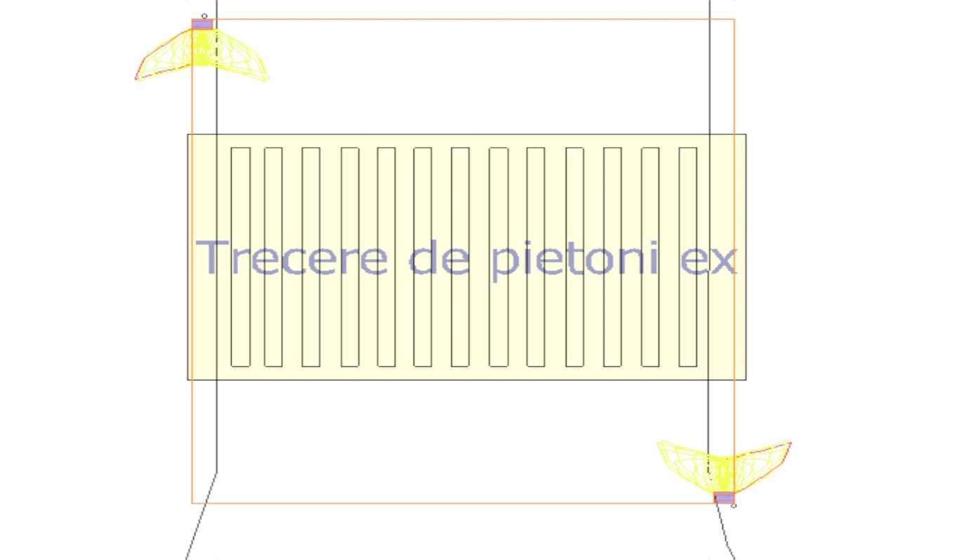
Crosswalk!

Slide 35
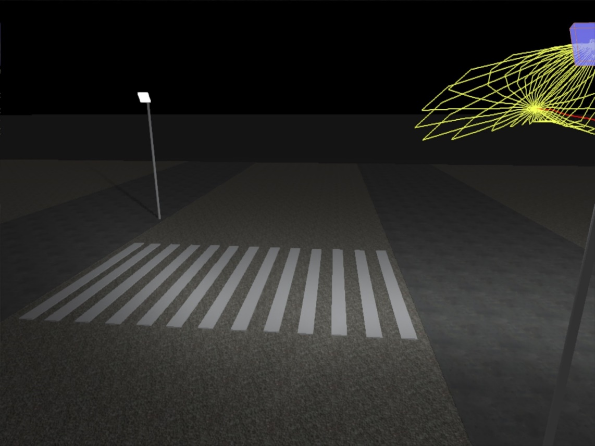
Pedestrian crossing: perspective

Slide 36
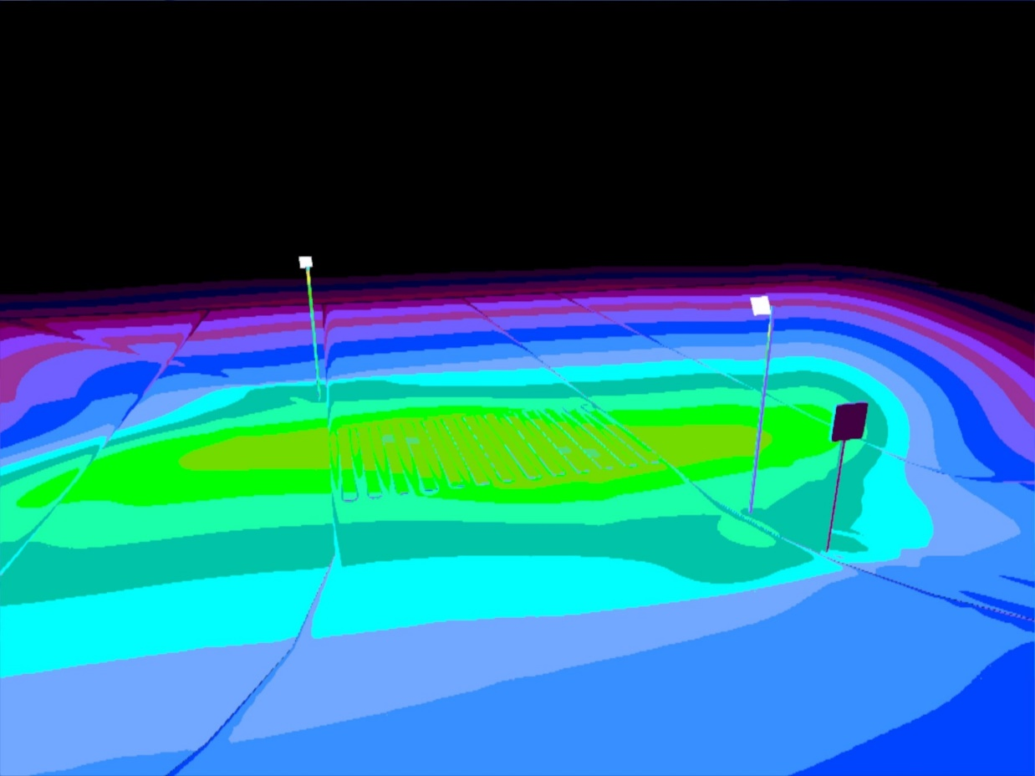
Asymmetric solution!

Slide 37
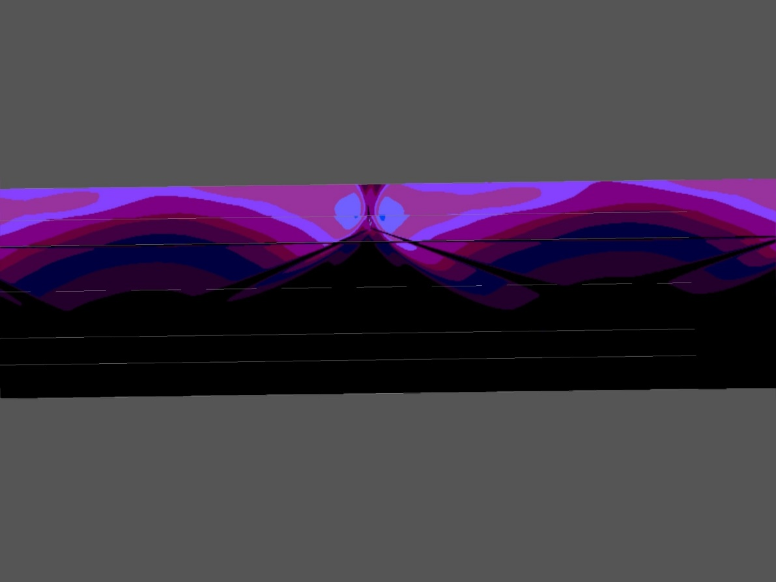
Sidewalk!

Slide 38
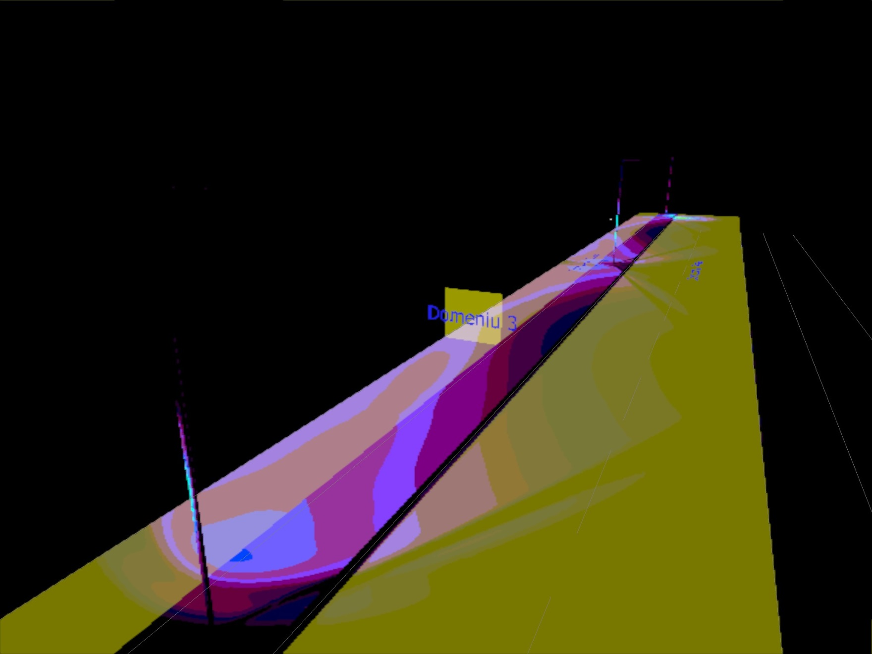
Iluminarea verticala!

Slide 39
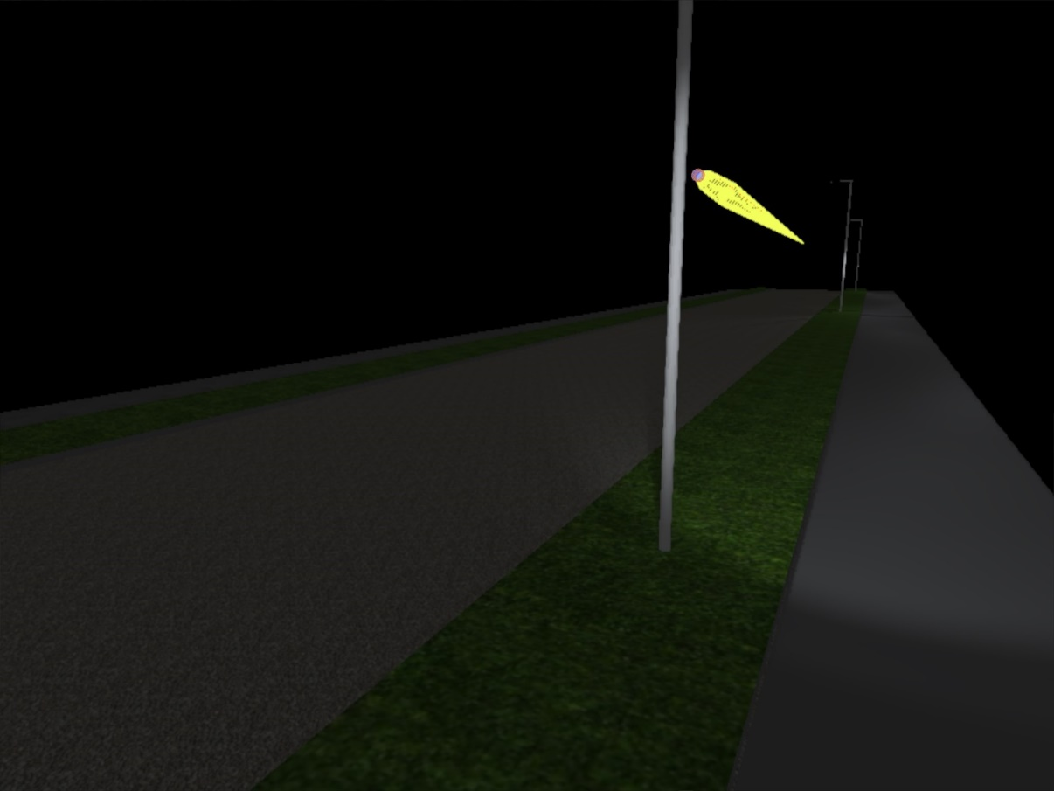
Sidewalk!

Slide 40
Conclusions:

