Slide 1
Development of renewable energy models for children education
Author: Vivien Balog
Case study tutor: Carmen Ibáñez Usach
Renewable energies tutor: Jose Segarra Murria
Rural development tutor: Vicent Querol
English tutor: Imre Baják
Professional supervisor: Zsuzsanna Kray

Slide 2
Outline
1. Introduction to the project
2. Previous hydraulic models
2.1. Previous hydraulic model option 1.
2.2. Previous hydraulic model option 2.
2.3. Previous hydraulic model option 3.
3. Previous eolic models
3.1. Previous eolic model option 1.
3.2. Previous eolic model option 2.
3.3. Previous eolic model option 3.
4. Previous photovoltaic models
4.1. Previous photovoltaic model option 1.
4.2. Previous photovoltaic model option 2.
4.3. Previous photovoltaic model option 3.
5. Final models
5.1. Final hydraulic model
5.2. Final eolic model
5.3. Final photovoltaic model

Slide 3
1. Introduction
This case study focuses on children education on renewable energies.
In this case study, three models will be designed and their respective pedagogical guides will be prepared. Firstly, three different types of models will be analysed: hydraulic, eolic and photovoltaic energy each of them focused on a type of energy transformation process.
For each model selected from the literature reviewed, different features will be presented:
Initial design of the model
Materials
Description of the process
Steps to build the model.
Finally, three new models will be designed concerning three types of energy transformation.
The main goal is: make students aware of the disadvantages of the different non-renewable sources and of the advantages of renewable energy sources.

Slide 4
2.1. Previous hydraulic model option 1.
Initial design of
the model

Slide 5
Description of the process
the water falls onto teaspoons
wheel starts to turning
generator generates electricity
crocodile clip leads the current
Led diode is lighting

Slide 6
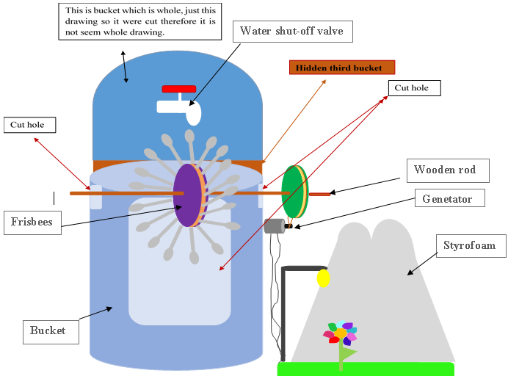
2.2. Previous hydraulic model option 2.
Initial design of the model

Slide 7
2.3. Previous hydraulic model option 3.
Initial design of the model
Plastic spoons

Slide 8
3.1. Previous eolic model option 1.
Initial design of the model

Slide 9
Description of the process
Turn on hair dryer
wind reaches the turbine and the turbine starts to turning
Generator
generates electricity
Led diode
Led diode is lighting

Slide 10
3.2. Previous eolic model option 2.
Initial design of the model

Slide 11
3.3. Previous eolic model option 3.
Initial design of the model

Slide 12
4.1. Previous photovoltaic model option 1.
Initial design of the model

Slide 13
Description of the process
Sun rays get to solar panel
Producing current to battery
Ventilator is turning

Slide 14
4.2. Previous photovoltaic model option 2.
Initial design of the model

Slide 15
4.3. Previous photovoltaic model option 3.
Initial design of the model

Slide 16
5.1. Final hydraulic model

Slide 17
5.2. Final eolic model

Slide 18
5.3. Final photovoltaic model

Slide 19
Thank you!

Slide 20
Development of renewable energy models for children education
Author: Vivien Balog
Case study tutor: Carmen Ibáñez Usach
Renewable energies tutor: Jose Segarra Murria
Rural development tutor: Vicent Querol
English tutor: Imre Baják
Professional supervisor: Zsuzsanna Kray

