Slide 1
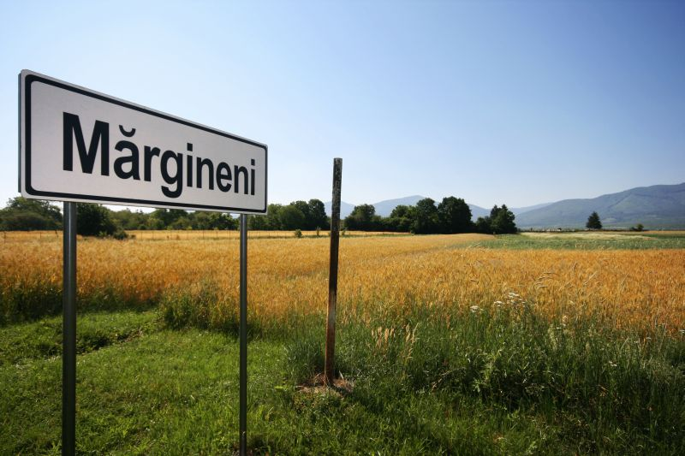
Study concerning optimization of photovoltaic lighting system in Margineni village
By: Dora Okos
Bacau, 2017.04.27.

Slide 2
The case study’s goal: propose a modern, energy-, and cost saving system for a street, where no lighting system in Margineni

Slide 3
1. Investigate the current system
Project
2. Alternatives to the solution
3. Propose a correct system

Slide 4
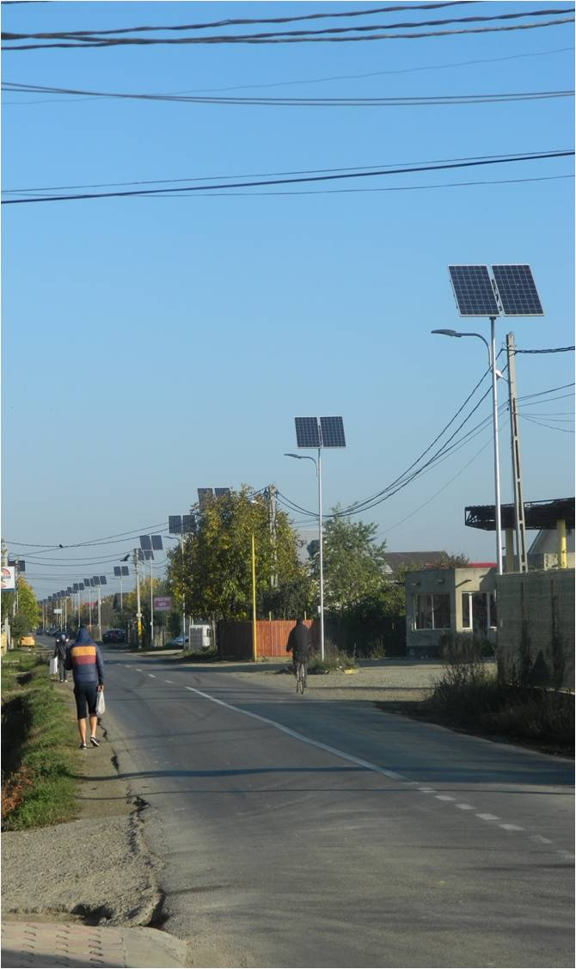
Current system
Works well, but there are some street where no lighting system
Each lighting pole is a standalone system, without control management
Non-dimmable → necessary to choose an other system for the final solution

Slide 5
Alternatives
Important criterias in the choice:
- Dimmable fixtures - Adequate light for the street ( access street, 150m length, 4m width) - Acceptable prices - Low energy consumption - Suitable control system ( many types of the system) - Easy access and manageability

Slide 6
Proposed system
Proposed system’s elements:
LED lamp – Pegaso 36
Solar panel - Shinetime Solar XTP6-60-240
PV charge regulator - WRM-15
Battery - FIAMM 12FGL27
Inverter - MP Genius 20-24 Plus
Remote control - Orionview
Pole, and pole support - GLS Hline-T
Battery box

Slide 7
Important Datas
The proposed LED lamp’s energy consumption: 50 W
Average time for the public lighting in Romania : 4000h / year
Energy price in Romania: 0,097 Euro
Minus hours at one night by the control system: 3 hour

Slide 8
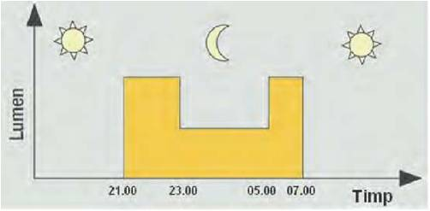
Results
Calculations: - For the street necessary to install 5 system ( 8m height, and 30m between two poles) - Use the control system in 6 hours/night with 50% lighting power→ 27% reduction - The control system use 638,75 kWh in one year, a traditional system use 1825 kWh in one year.

Slide 9
Results
Budget - Total installation cost of the system: 1 -2500 Euro; 5- 12500 Euro - Compraison: HPS vs LED costs

Slide 10
Thank you for your attention!

